Slide 1
LIVE.LONG.DC. Stakeholder Summit
July 27, 2022
Summary Report

Slide 2
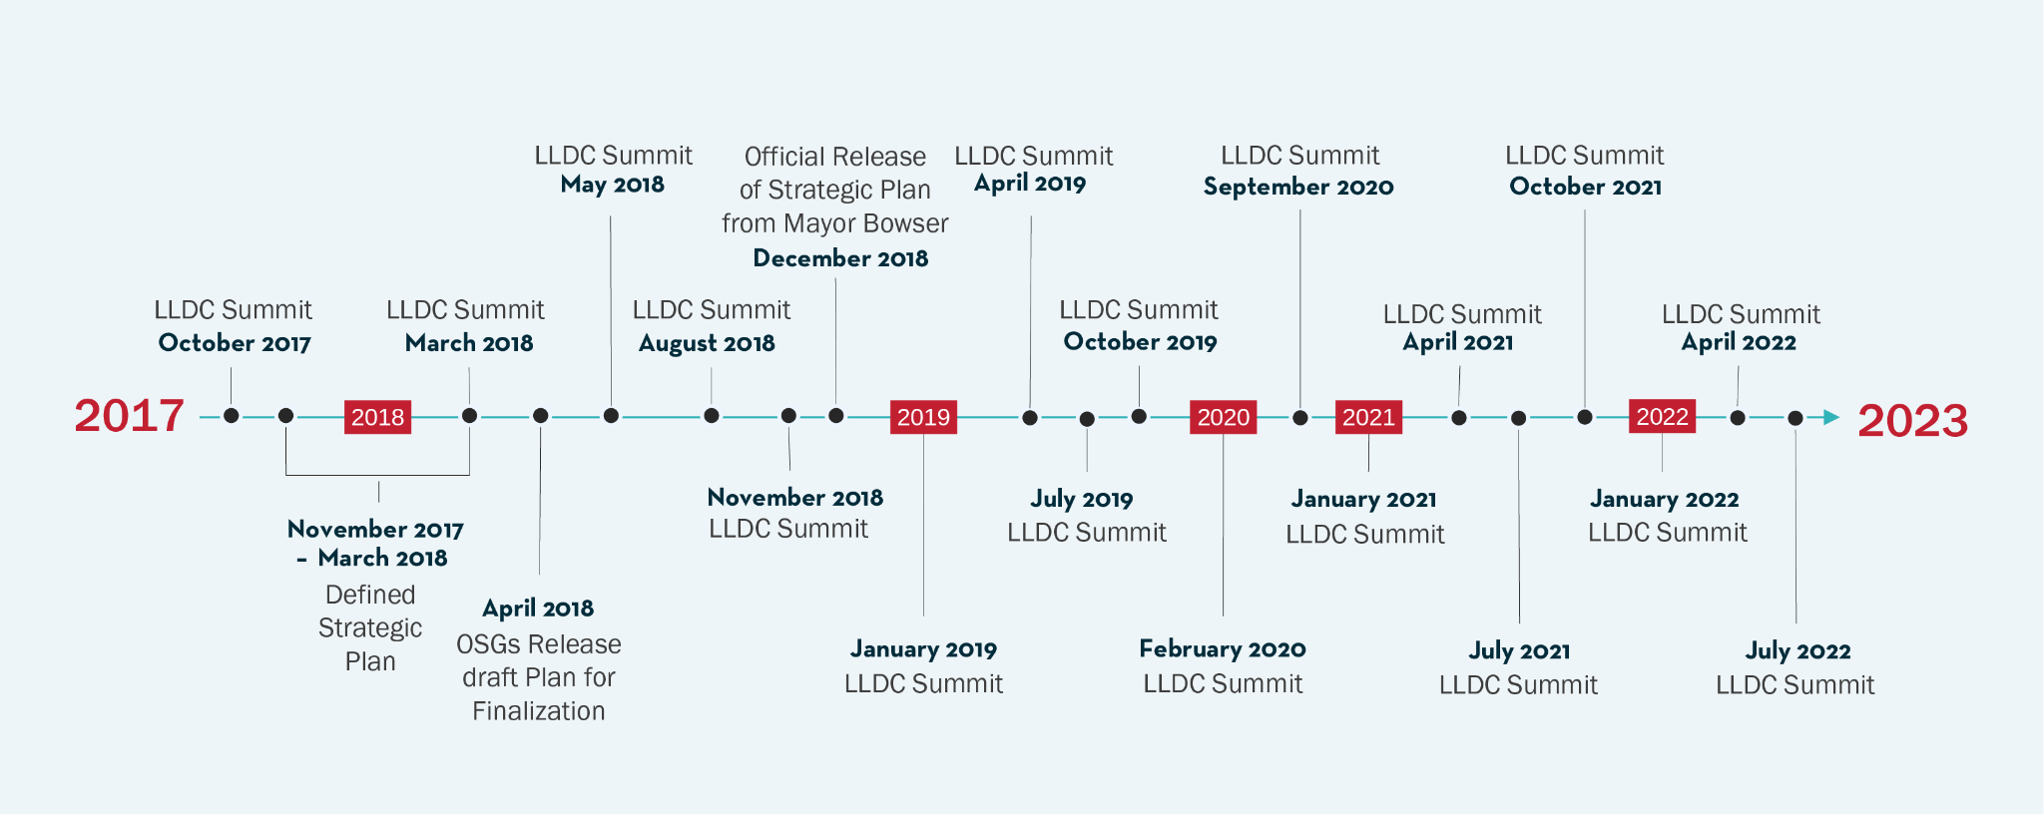
LLDC Milestones

Slide 3
LLDC Ecosystem

Slide 4
What You Need to Know. What We Need to Do.
PURPOSE
To convene the LIVE. LONG. DC. stakeholder community in a forum of learning and action planning for executing strategies to save lives from opioid overdoses.
OUTCOMES
Shared learning across the continuum of care for the LLDC stakeholder community
Shared understanding of cross-agency and cross-organizational opportunities for collaboration and coordination
AGENDA
Opening Remarks
Data Highlights
Stigma Presentation
Faith-Based Panel
Opioid Strategy Group Breakouts
Closing Remarks

Slide 5
Poll Question
Where do you work within the LIVE.LONG.DC. community?

Slide 6
Presentations
Noah Burton, DC Department of Behavioral Health
Fire and Emergency Medical Services (FEMS) Overdose Responses: Bystander Naloxone Administration and Patient Transport
DBH noted that the general public may not know the signs and symptoms of an overdose and shared data related to how frequently friends, family, and roommates administer naloxone when they are around someone who is overdosing. We need to continue to educate the public!
DBH introduced a new initiative called FEMS Overdose Response Teams. These teams will be comprised of a paramedic and a community outreach specialist, and they follow up with individuals who overdose and decline transport to the hospital. They will connect them to other resources outside of the ER setting.
Jona Tanguay, Whitman Walker Health
Using Evidence-Based, Life Affirming Language for People Who Use Substances, and People Living with a Substance Use Disorder
Jona discussed the harm that stigmatizing language causes patients. For example, Jona shared that mental health care practitioners attending professional conferences were less likely to believe individuals deserved treatment when they were described as a “substance abuser” rather than a “person with a substance use disorder.”
Jona walked through alternative, non-stigmatizing language and educated participants on the spectrum of opioid use disorder (OUD).

Slide 7
Faith-Based Organizations Panel
Charles Dark, Director of Wards 5 & 6 DC Prevention Center, moderated a discussion among the four panelists named below. The panelists shared the following:
Good Success Christian Church and Ministries distributes naloxone door to door in Ward 7 in response to data showing that the majority of overdoses occur in residences.
Nevertheless Outreach Ministries provides counseling for individuals with and connects them to treatment options, if desired.
Masjid Muhammad works closely with youth to educate them on OUD.
Westminster Presbyterian Church launched a very successful international overdose awareness day (IOAD) event last year and plans to do the same this year.
Qadir Abdus-Salaam, Masjid Muhammad
Elder George Kerr, Westminster Presbyterian Church
Elder Joe Johnson, Good Success Christian Church and Ministries
Sherlene McIntosh, Nevertheless Outreach Ministries

Slide 8
Opioid Strategy Groups (OSGs) Breakout Group Topics
Prevention, Education, and Coordination: Evidence-Based Prevention Practices in Schools
Harm Reduction: What is the Harm Reduction Futures Fund? with Guest Speaker Christine Rodriguez at AIDS United
Treatment: How Stigma Affects Treatment-Related Activities
Recovery: National Recovery Month Discussion with a Speaker from Faces and Voices of Recovery
Interdiction and Criminal Justice: Analysis of the Number of Opioid-Related Arrests in the District and a Discussion on Messaging Strategy

Slide 9
Opioid Strategy Group (OSG) Breakout Sessions
Prevention, Education, and Coordination: Evidence-Based Prevention Practices in Schools
Received an update from the DBH Prevention Team on partnerships with Prevention Centers and school-based clinicians.
Discussed with a DC Health epidemiologist ideas for communication to the community following an overdose spike in order to prevent further overdoses.
Harm Reduction: What is the Harm Reduction Futures Fund? with Guest Speaker Christine Rodriguez at AIDS United
Learned about community-based participatory funding for harm reduction grants.
The Harm Reduction Futures Fund’s community-based approach allows for funding of programs that other organizations and the government cannot fund due to various funding restrictions.

Slide 10
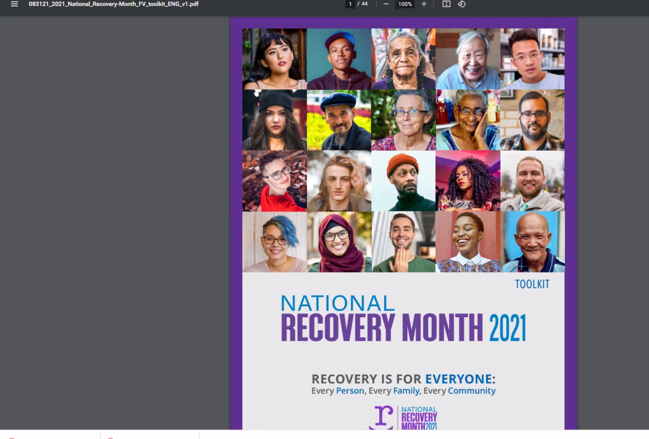
Opioid Strategy Group (OSG) Breakout Sessions (continued)
Recovery: National Recovery Month Discussion with a Speaker from Faces and Voices of Recovery
Shared updates regarding Recovery Month activity planning.
Discussed types of events that occur during Recovery Month, audiences, and stigmatizing words and images to avoid.
Planned for the LLDC Recovery Forum.
Slide from the National Recovery Month Toolkit

Slide 11
Opioid Strategy Group (OSG) Breakout Sessions Cont.
Treatment: How Stigma Affects Treatment-Related Activities
Continued the discussion on addressing stigma with a goal to brainstorm potential plans that can be shared across OSGs and with DBH.
Key themes for recommendations included:
Drafting consistent language recommendations for DBH grantees, OSGs and others to reference for our collective work.
Exploring immediate/near-term options for incorporating appropriate language into our current work.
Developing ideas for future goals for LLDC to focus more directly on addressing stigma in the Treatment OSG.
Screenshot from the Treatment OSG’s JamBoard

Slide 12
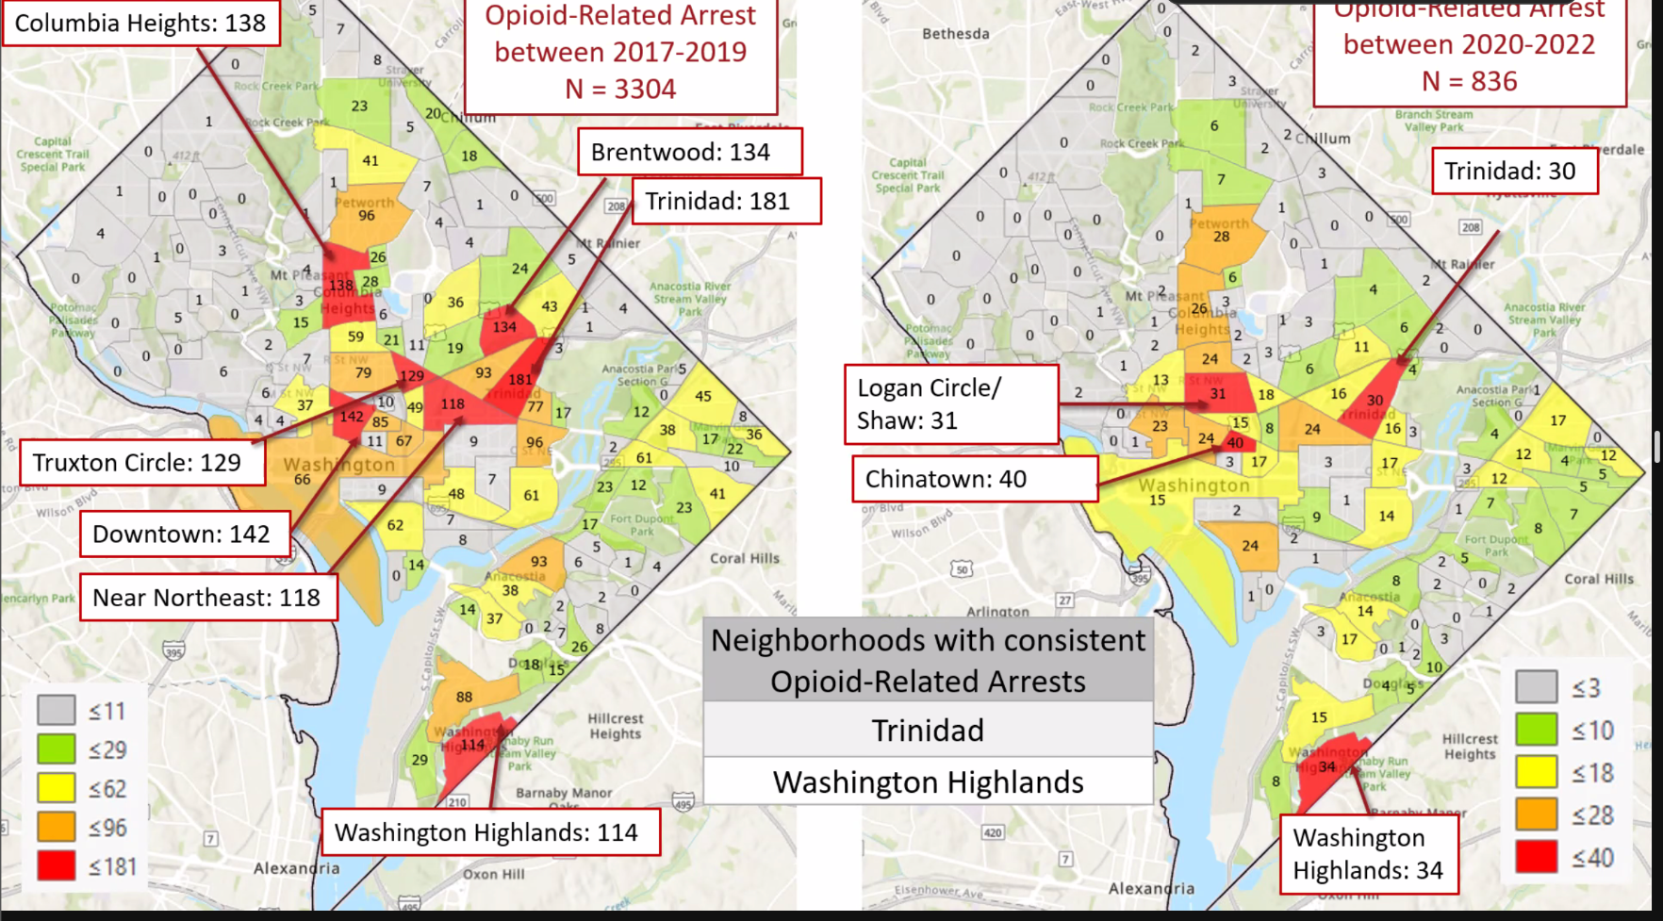
Opioid Strategy Group (OSG) Breakout Sessions Cont.
Interdiction/Criminal Justice: Analysis of the Number of Opioid-Related Arrests in the District and a Discussion on Messaging Strategy
Discussed possible ways of developing a messaging campaign for a stigma-reducing effort for the criminal justice system, and strengthening connections to treatment between criminal justice system touchpoints.
Discussed a recent CJCC analysis of opioid-related arrest trends in the District. Several OSG workgroup members shared their interest in decriminalization efforts.
Slide from Interdiction/Criminal Justice breakout presentation

Slide 13
LIVE.LONG.DC. Stakeholder Summit Design and Facilitation Support
The Clearing, Inc.
Jonathan Spector
202.558.6499
Jonathan.Spector@theclearing.com

